Slide 1
Theory in Psychology
Experimental Psychology

Slide 2
What is a theory?
Theory = broad explanation of a phenomenon
Phenomenon = a result that has been studied empirically (i.e., through research)
A theory is not the same thing as a hypothesis
A hypothesis is much more specific than a theory (it is a specific prediction about the results of a study)

Slide 3
Why are theories important?
Help organize information
E.g., organize aspects of intelligence
Help us predict future occurrences of phenomena
What will be the best type of therapy for PTSD?
Help us generate new research questions/hypotheses
If exposure therapy is helpful for people with PTSD, is it helpful for people with other anxiety disorders?

Slide 4
Nested Theories
Theories can be interrelated
E.g., Zajonc’s Drive Theory encompasses both social facilitation theory and social inhibition theory

Slide 5
Theories, Perspectives, Models, and Hypotheses
Theory- broad explanation of phenomena
Perspective- broader explanation than theory
E.g., behaviorism, biopsychosocial perspective
Model- precise explanation of phenomena
E.g., Three-Component Processing model of memory
Hypothesis- specific prediction
E.g., people will be more likely to remember an emotionally charged event than a neutral event

Slide 6
Same Phenomenon, Differing Theories
Researchers consider multiple theories
E.g., theories of intelligence
Theories can be competing or complementary
Competing theories- One more accurate than the other
Sociocognitive model vs. posttraumatic model for DID
Complementary theories- Both are equally accurate; describe different aspects of same phenomenon
Learning perspectives

Slide 7
Same Phenomenon, Differing Theories
Think of at least three different theories to explain the observation that married people tend to report greater levels of happiness than unmarried people.

Slide 8
Variety of Theories in Psychology
Formality: How specific/precise is the theory?
Informal←→ Formal
Scope: The number and variety of phenomena explained or interpreted by a theory
Broad←→ Narrow

Slide 9
Variety of Theories in Psychology
Theoretical approach
Functional theory: Explains phenomena in terms of their function or purpose
E.g., Evolutionary psychology
Mechanistic theory: Explains phenomena in terms of underlying variables, structures, and processes, and the interactions among them
E.g., Model for explaining hypochondriasis
Stage theory: Explains phenomena in terms of stages.
E.g., Maslow’s hierarchy of needs, Freud’s stages of psychosexual development

Slide 10
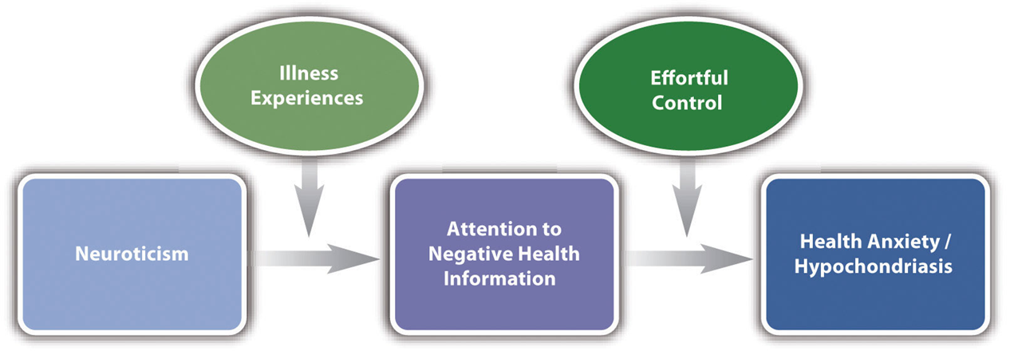
Contemporary (Mechanistic) Theory of Hypochondriasis

